Slide 1

The Shift in Spend: Key Shopping Behaviours
This presentation highlights key shopping trends based on customer purchase behaviour and demographics. It includes insights on total sales by category, average product ratings by gender, and the top 5 most purchased items. We explore subscription conversion by age, seasonal discount patterns, and preferred shipping methods. The data also reveals return rates, frequency of purchases by customer type, payment method popularity, and promo code usage by gender. Lastly, we look at seasonal sales trends to uncover peak shopping periods. These findings aim to support smarter business decisions across marketing, sales, and customer engagement strategies.

Slide 2
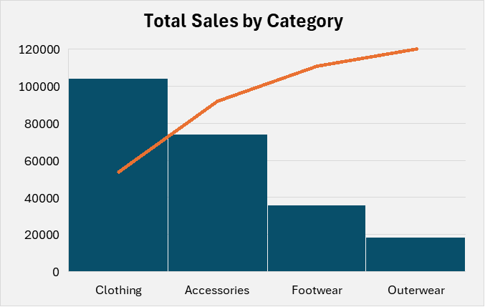
Total Sales by Category
The Clothing category generated the highest sales, highlighting it as the top-performing product line and a key revenue driver. This reflects strong consumer demand and consistent purchasing behaviour in this segment. On the other hand, Outerwear recorded the lowest sales, indicating it may not be aligning with customer needs or seasonal demand. This gap presents an opportunity to optimize stock levels, reassess marketing efforts, or introduce new styles to improve performance in the outerwear segment.

Slide 3
Average Rating by Gender
Male customers provided the highest average ratings (3.75), indicating slightly greater satisfaction with their shopping experience compared to female customers (3.74). This may suggest a better alignment between product offerings and male customer expectations or differences in engagement post-purchase. Exploring ways to enhance satisfaction among female shoppers could lead to an improved overall customer experience.

Slide 4
Top 5 Most Purchased Items
Blouses generated the highest sales, making them the top-performing product in terms of revenue. This reflects their consistent demand and central role in customer purchases. Jewellery, though part of the top 5, contributed the least in sales among them, showing moderate interest but lower revenue impact compared to other top items. This suggests customers prioritize essential clothing over accessories when spending.

Slide 5
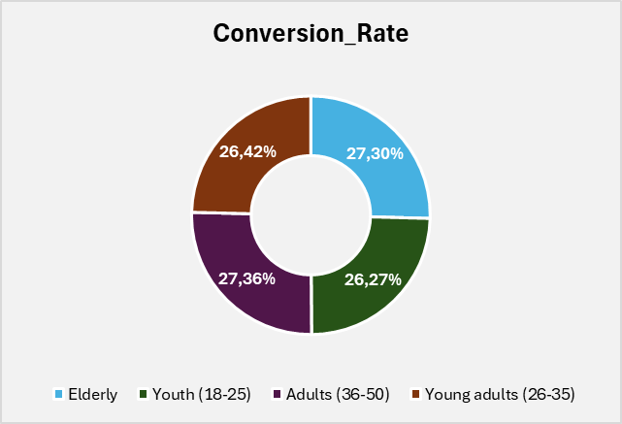
Subscription Conversion by Age Group
Adults aged 36–50 showed the highest subscription conversion rate at 27.36%, indicating a strong engagement with long-term offers or loyalty programs. The Elderly group followed closely at 27.30%, suggesting older customers also value subscription benefits. Interestingly, Young Adults (26–35) and Youth (18–25) had slightly lower rates at 26.42% and 26.27% respectively, which may imply a preference for flexibility or less brand commitment among younger demographics.

Slide 6
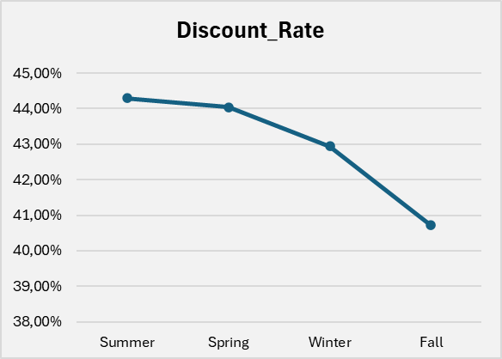
Average Discount per Season
The analysis of average discounts by season reveals that Summer experiences the highest discount rates, indicating that retailers tend to offer more promotions and price reductions during this period to encourage customer spending. In contrast, Fall has the lowest average discount rate, suggesting a more conservative discount strategy or reduced promotional activity in that season. This seasonal variation in discounts likely reflects marketing efforts aligned with customer demand and sales cycles throughout the year.

Slide 7
Compare Shipping Type by Orders
The data shows that Free Shipping is the most preferred shipping method, with 675 orders, highlighting customers’ strong preference for cost-free delivery options. On the other hand, 2-Day Shipping is the least popular choice, with 627 orders, indicating that faster shipping options with a moderate delivery time may be less attractive to customers compared to free or standard methods. This insight suggests that offering free shipping can significantly influence customer ordering behaviour.

Slide 8
Compare Shipping Type by Average Spend
When comparing average spend by shipping type, customers who choose 2-Day Shipping tend to spend the most on average, suggesting that faster delivery options attract higher-value purchases. In contrast, those selecting Standard Shipping have the lowest average spend, indicating that shoppers opting for the most economical delivery method may make smaller purchases. This pattern highlights a potential link between shipping speed and customer spending behaviour, where quicker shipping is associated with higher spending.

Slide 9
Customer Return Rate
The customer data indicates that Returning customers make up the largest group with 2,794 orders, highlighting strong repeat business and customer loyalty. In comparison, Loyal customers account for 682 orders, while New customers contribute 424 orders. This distribution suggests that a significant portion of sales relies on customers who come back repeatedly, emphasizing the importance of retention strategies to maintain and grow this valuable segment.

Slide 10
Payment Method Popularity
Among the payment methods, PayPal stands out as the most popular choice among customers, reflecting its convenience and widespread acceptance. In contrast, Bank Transfer is the least used payment option, suggesting that customers may prefer faster or more user-friendly methods over traditional bank payments. This insight highlights the importance of offering diverse and seamless payment options to cater to customer preferences

Slide 11
Promo Code Usage Rate by Gender
The promo code usage data reveals a striking difference between genders: over 60% of male customers use promo codes, whereas female customers show virtually no usage at 0%. This significant disparity suggests that promotional offers may be more appealing or better targeted toward male shoppers, or that females may be less aware of or interested in using promo codes. Understanding the reasons behind this gap could help tailor marketing strategies to improve promo code engagement across all customer segments.

Slide 12
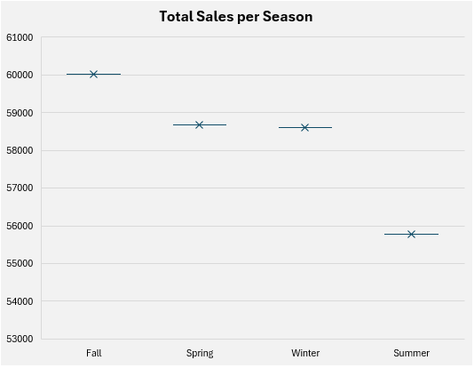
Sales Trend by Season
The total sales analysis by season shows that Fall generates the highest sales, despite offering fewer discounts, indicating strong customer demand during this period. Conversely, Summer records the lowest total sales, even though it featured the highest discount rates. This suggests that while summer promotions attract discount-driven purchases, they may not fully compensate for the lower overall sales volume compared to other seasons. Understanding these seasonal trends can help optimize pricing and marketing strategies throughout the year.

Slide 13
Frequency purchase based on customers
The purchase frequency analysis reveals distinct buying patterns across customer types. Loyal customers tend to purchase more frequently, with intervals such as weekly, bi-weekly, and fortnightly being common, reflecting their strong ongoing engagement with the brand. Returning customers show a mix of frequencies, often shopping monthly, quarterly, or every three months, indicating a moderate but consistent purchasing behaviour. In contrast, new customers generally have less frequent purchases, often at annual or quarterly intervals, as they are still developing their relationship with the company. Understanding these frequency patterns helps tailor marketing and retention efforts to each customer segment more effectively.

Slide 14
Overall Insight
In summary, the analysis of shopping behaviour reveals clear patterns in how customers interact with discounts, shipping options, payment methods, and purchasing frequency. Fall stands out as the highest-performing season in terms of total sales, while Summer highlights the limitations of heavy discounting.
Customer loyalty plays a key role in sales volume and frequency, and popular choices like Free Shipping and PayPal show that convenience remains a top priority for shoppers. The insights uncovered point to specific opportunities—such as expanding targeted promotions and improving seasonal strategies—that can drive both customer satisfaction and business growth.
Moving forward, leveraging these findings will be essential in shaping smarter, more data-driven decisions that align with evolving customer preferences.

Slide 15
Suggestions
Enhance Free Shipping Offers- Since free shipping is the most popular option, consider expanding free shipping thresholds or promotions to encourage higher order values and increase customer satisfaction.
Target Promo Codes to Female Customers- With females showing 0% promo code usage, create targeted campaigns or exclusive offers to boost their engagement with discounts and promotions.
Leverage Seasonal Strategies- Focus marketing efforts on Fall when sales are naturally higher but also experiment with strategies to boost Summer sales beyond discounts, such as exclusive products or events.
Promote Faster Shipping Options to High Spenders- Since customers who choose 2-Day Shipping spend more on average, offer incentives to upgrade shipping for mid-tier spenders to increase average order value.
Simplify Payment Options- Maintain and promote popular payment methods like PayPal and explore ways to make less-used options like Bank Transfers more attractive or easier to use.
Personalize Marketing by Purchase Frequency- Tailor communication based on customer type:
Reward loyal customers with frequent purchase perks or early access to sales.
Engage new customers with onboarding offers and reminders to encourage more frequent purchases.
Analyse Promo Code Effectiveness- Regularly review promo code campaigns to identify what drives usage among different segments and optimize messaging accordingly.

Slide 16

CONCLUSION
Clementine Moholeng

